Slide 1


Welcome to Gnod's World of Music

Slide 2




GNOD recommendation system:
Based on pre-prepared song groups
Huge base of music features
Compatible with Billboard Hot 100 list
Keeps the user informed and trendy

Slide 3





World’s Top 5 music apps

Slide 4
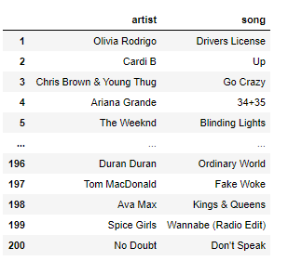


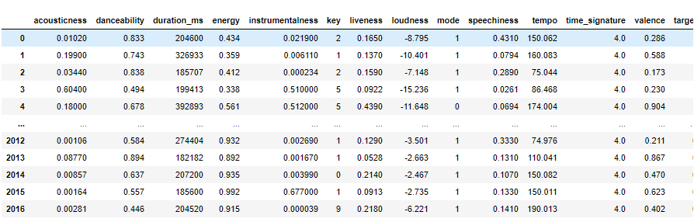

Slide 5
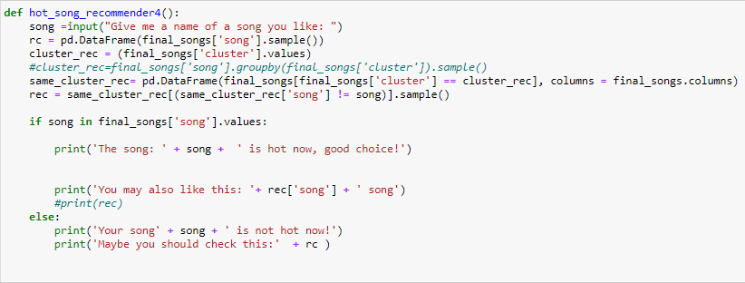

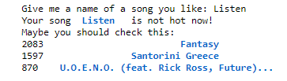
How does it work?

